Slide 1
SAMHAR COVID-19 CORDiscovery
An information retrieval and text summarization engine
Team
Ajay Dadheech
Snigdha Bhardwaj
Vinay Garg
Vishal Jain

Slide 2
Solution Overview
Problem Statement
With Covid-19 becoming a pandemic the research on same has also accelerated - more than 44000 research articles already published and growing. The objective is to analyze the existing literature for analysis including question, answering and summarization which helps in getting better and faster insights
Approach for POC
Level 1: Embeddings generation using ensemble and document scoring
An ensemble framework to rank the documents using various Natural Language Processing techniques –
TF-IDF (Cosine Distance): Determines the importance of an individual word relative to a document
Topic Modeling (Latent Semantic Analysis): Assigns particular words to clusters (or word clouds) that contain similar terms
BERT: Bidirectional Encoder Representations from Transformers (BERT) is a pre-trained model developed by Google. Unlike traditional RNNs or LSTMs, which only learn in one direction, BERT is trained in both directions and thus is better at understanding context.
SciBERT: pre-trained model on medical journal articles and would be more applicable for the existing case
Storing generated document embeddings in Elastic search for near real time search using Dense Vector API
Retrieving top N documents from the ranked ensemble
Level 2: Extractive summarization for relevant documents
Generating extractive summaries using pre-trained BERT text summarizer
It works by embedding the sentences of retrieved documents, running a clustering algorithm and finding the sentences that are closest to the cluster's centroids.

Slide 3
Solution Overview
Key Observations
More contextual results with ensemble approach (ranging from more basic methods such as TF-IDF to SciBERT) and contains both pre-trained and fine-tuned version on CORD19 dataset
Significant retrieval speed up (around 5X) and near real time search over vector space with script score query in Elasticsearch
Path Forward
Add other ML based techniques to the ensemble framework like Swivel co-occurrence matrix factorization model (https://arxiv.org/abs/1602.02215)
Train and incorporate abstractive summarization model to achieve better summarized text results
Package and containerize the whole system where each component (levels) can work as an independent service
Dataset Used
COVID-19 Open Research Dataset (CORD-19) [Open source data set by Allen Institute for AI]
Current Infrastructure
For training, 4 NVIDIA V100 GPUs on p3.8xlarge AWS instance with 128 GB RAM
Git Repository
https://github.com/vinaygarg30/CORDiscovery

Slide 4
Key Components & Process Workflow
Traditional keyword-based information retrieval engines perform good at finding real-time information on general COVID-19 questions but lack to provide relevant semantic results for complex queries like ‘Exploration of use of best animal models and their predictive value for a human vaccine.’
Our solution aims to deploy a semantic search mechanism (ensemble modelling approach) to gather efficient information on CORD dataset. CORDiscovery (our proposed solution) has the following key components –
The stages in the process workflow are divided into 2 broad tasks (based on the frequency of execution) -
Data Preparation and Wrangling
Generation of embeddings for the document corpus for different techniques in ensemble approach
Saving the model objects and configuration for later use
Data/embeddings ingestion into Elasticsearch as dense vectors
Generation of embeddings for user search input
Matching (input embeddings and document vectors) based on cosine similarity
Summarizing the retrieved documents using BERT summarizer
Displaying search results
Ensemble Modelling
Elasticsearch
BERT Summarizer
Flask UI
CORDiscovery
One-time process
Query based recurring tasks

Slide 5
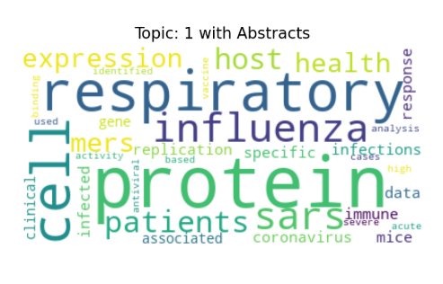
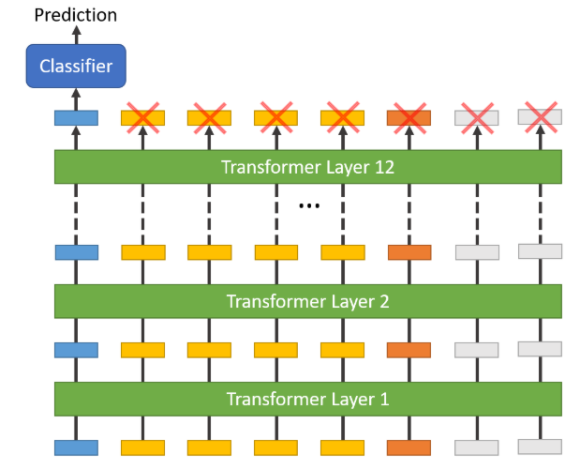
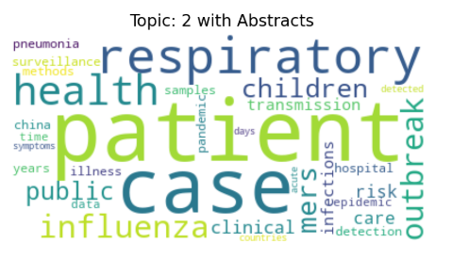
Analytical Workflow
User search terms
Level 1
Advantages:
Not overly reliant on one single method due to the ensemble framework
Uses a variety of NLP tools ranging from more basic methods such as TF-IDF to SciBERT
Contains both pre-trained methods and methods trained on the actual data
TF-IDF
Topic Modelling
BERT/SciBERT
Document 1001
Rank 1
Similarity Score: 0.65
Document 202
Rank 2
Similarity Score: 0.55
.
.
.
Document N
Rank m
Similarity Score: 0.01
Average rank of documents (ranking based on similarity score)
Level 2
Top N documents identified by the average ranking
Doc 1
Doc 2
Doc 3
…
Summarize documents to get most relevant information
Doc 1, Doc2, Doc3
<Summary of findings>
Final output shown intuitive dashboard
User input: <Keyword Search>
Top Relevant Results:
Doc 1, Doc2, Doc3 etc.
Summary of findings

Slide 6




Architecture Diagram
Saved Document Embeddings
Ensemble
Model
Embeddings
Analytical Engine
Top ranked documents
Ensemble
Model
Search Phrase
BERT Text
Summarizer
Relevant documents, summaries and other information

Slide 7




Team Profile
8 years of experience with Big Data, IOT, Data Analytics & Business Intelligence. Skilled in Predictive modeling, segmentation & analysis on sensor data. He is focused on delivering complex outcomes-based projects, managing cross-functional teams of consultants, data scientists, and technology architects.
4 years of experience in developing predictive models with primary focus on analytics-based products and IOT analytics. Worked across hospitality, CPG and telecom and mining domain using various data science tools like R, Python and SPSS
Ajay Dadheech
Data Science Manager
Snigdha Bhardwaj
Senior
Data Scientist
Vishal Jain
Data Analyst
Vinay Garg
Data Engineer
3 years of experience in engineering AI enabled enterprise solutions for Food, Beverage and CPG industries. He conducts research in innovative analytical algorithm, tools and building scalable data pipelines
Expertise in Java, Python and AWS
Experienced with Monte Carlo, Classification, Marketing analytics and distributed computing
B.Tech. Computer Science
M.A. – Economics
B.Tech. Computer Science
B.Tech. Electrical Engineering

